Slide 1
Milton Public Schools School-Based MCAS Presentation: Linking Data to Action
School Committee Presentation October 1, 2014
Collicot Elementary School Cunningham Elementary School
Mrs. Holly Concannon, Principal Mr. Jonathan Redden, Principal
Glover Elementary School Tucker Elementary School
Dr. Sheila Kukstis, Principal Dr. Elaine McNeil-Girmai, Principal
Pierce Middle School Milton High School
Dr. Karen Spaulding, Principal Mr. James Jette, Principal

Slide 2
Agenda
How do we look at data?
Elementary Level
What do we “see” in the data?
How do the data translate into focus areas?
How are we currently addressing these focus areas?
Pierce Middle School
What do we “see” in the data?
How do the data translate into focus areas?
How are we currently addressing these focus areas?
Milton High School
What do we “see” in the data?
How do the data translate into focus areas?
How are we currently addressing these focus areas?
Advancement Initiatives 2.0 Update

Slide 3
Slicing the Data: What Do We Look At?
Accountability data sheet
Results in the aggregate and by subgroup
School achievement distribution by year
Detailed school achievement distribution
School achievement and growth
School growth distribution
School results by standards
School test item analysis
DART (District Analysis, Review, and Assistance Tools) and MCAS Cube (allows multi-dimensional drill through reports)
Student results (achievement, by standard, history)
Cohort achievement history

Slide 4
Slicing the Data: When Do We Look At Data?
Elementary Level- Grade level meetings every other week; data analysis meetings (requires class coverage); monthly after school faculty meetings
Middle School Level- Regular meetings with leadership; bi-weekly department meetings to look at data by standard and subgroup; bi-weekly team meetings may utilize student data as one source of information; monthly after school faculty meetings
High School Level- Weekly leadership meeting with administration and department heads; monthly after school faculty meetings
All Levels- Principal and curriculum leadership analyze and reflect on data in a number of ways regularly beginning in June for the next school year; Student Achievement Focus Discussions (with Central Office).

Slide 5
Milton Public Schools Elementary Level Data Observations, Focus Areas, and Initiatives

Slide 6
Milton Public Schools Elementary Aggregate Data Observations
The district outperformed the state on all achievement levels in all content areas.
There is an historical increase in Proficient and Advanced students when tested in grade 5.
The number of Advanced and Proficient students in math in grades 3 , 4, 5 remained consistent.
In grade 4, the amount of students in Advanced and Proficient increased in math.
Grade 5 ELA and Math performance demonstrated the highest achievement and growth.
The number of grade 5 warning students in Science and Technology was decreased by half.
All grades demonstrated typical or higher than typical growth.
Median SGP in ELA for all grades exceeded the median SGP for Math by 3 percentage points (51,48).

Slide 7
Milton Public Schools Elementary Subgroup Data Observations
There is a significant gap between the High Needs* subgroup and Non-High Needs students in Grades 3-5 in ELA and Math.
By the time students reach grade 5, the gap begins to narrow.
A gap also exists in ELA and Math between the African American/Black and Hispanic/Latino subgroups as compared to the Asian and White subgroups.
The gap between Non Low Income and Low Income students has significantly decreased in Science.
The gap between African American and White students has significantly decreased in Science.
The gap between Non Special Education and Special Education students has significantly decreased in Science.
*High Needs subgroup includes students with disabilities, students identified as low income, and English Language Learners (ELL)

Slide 8
Milton Public Schools Elementary Data Highlights
Milton Public Elementary School Students performed better than the state in all content areas.
Students in Grade 5 scored above the median growth percentile in Math and ELA.
Grade 5 had the highest growth of all grades in the district in ELA in Math.

Slide 9
Milton Public Schools Elementary Focus Areas Rooted in the Data
Increase targeted instruction/remediation for students below benchmark (K-5) and at Needs Improvement (NI) and Warning (W) levels (grades 3-5); focus on subgroups who are underperforming (Advancement Initiatives- Emphasizing Early Literacy Achievement; Closing the Proficiency Gaps)
Move students from NI/W to Proficient (Advancement Initiatives- Closing the Proficiency Gaps)
Move students from Proficient to Advanced
Grades 3 ELA (Advancement Initiatives- Emphasizing Early Literacy Achievement; Closing the Proficiency Gaps)
Grade 4 ELA and Math (Advancement Initiatives- Emphasizing Early Literacy Achievement; Closing the Proficiency Gaps)
Science and Technology/Engineering curriculum and instruction (Advancement Initiatives- Advancing Science and STEM)
Notes:
Foss Science from scientists

Slide 10
Milton Public Schools Elementary Initiatives
Emphasizing Early Literacy Achievement
Reading Specialists in English and French
Grade 3 Specialized Reading Support (Winokur, Berges)
Professional Development in Literacy
Librarian/Media Specialist
Reading Assessments
New instructional materials
Technology funded by MFE (Chromebooks, IPADs, and Kindles to be purchased and utilized to support this and all initiatives.)
Partnerships with families
TS GOLD & Creative Curriculum , Kindergarten & Preschool

Slide 11
Milton Public Schools Elementary Initiatives (cont.)
Closing the Proficiency Gaps
Professional Development in ELA, Math, Science, and STEM
Increased Digital Literacy Support (Dr. Angela Burke)
Common Assessments and data analysis (DDM)
Extended day learning opportunities
Everyday Math Online and Study Island
Advancing Science and STEM
Science coordinator to support science and STEM
Implementation of STEM program in grade 3
FOSS Instructional Materials
Science from Scientists in Grade 5
Increased Preschool Enrollment
Pilot of the Kindergarten Readiness Program at Tucker

Slide 12
Milton Public Schools Pierce Middle School Data Observations, Focus Areas, and Initiatives

Slide 13
Pierce Middle School Aggregate Data Observations
Achievement in English Language Arts (ELA) and Math in grades 6-8 remains above the State with ELA achievement notably higher than achievement in Math. Achievement in both remains somewhat flat with the exception of Grade 7 ELA, which has shown improvement.
Achievement in Science and Technology/ Engineering (STE) remains below performance levels of ELA and Math, yet there was a small increase in the % of students in Advanced/Proficiency for STE.
Median Student Growth Percentiles (SGP) are in the “typical” range for all grades in ELA and Math.
Cohort data reveal improvement from Grades 6 to 8 in ELA with the number of students in W/NI cut almost in half.
Cohort data reveal lower achievement in Math in Grades 7 and 8 as compared to achievement in Grade 6.

Slide 14
Pierce Middle School Subgroup Data Observations
There exists an achievement gap in English Language Arts, Math, and Science & Technology/Engineering for all subgroups when compared to their counterparts.
The most notable achievement gap exists between students with and without disabilities in ELA, Math, and STE.
The most notable “student growth gap” exists between low income/non-low income subgroups in Math.
The largest gaps exist in Math and Science & Technology/Engineering.
The achievement gap appears to be narrowing for all subgroups in English Language Arts, but is not for Math and Science & Technology/Engineering.

Slide 15
Pierce Middle School Data Highlights
88% of ALL students were Proficient or Advanced in English Language Arts (ELA).
48% of 6th grade students scored Advanced in Math.
In ELA the 7th Grade performed better than 88% of 7th Grades in Massachusetts.
In Math 6th Grade performed better than 85% of 6th Grades in Massachusetts; 8th Grade performed better than 79%.
Our annual PPI for all students is up 15 points since last year.
Our annual PPI for High Needs students is up 25 points.
We earned extra credit points for shifting African American/Black students into Advanced categories in Math and Science & Technology/Engineering.
We increased the number of students w/disabilities in Proficient/Advanced in Science and Technology/Engineering by 10%.
We increased percentage of students in High Needs category who scored Proficient/Advanced In ELA by 11%.

Slide 16
Pierce Middle School Focus Areas Rooted in the Data
Full implementation of the new science curriculum with the addition of new common unit assessments (Advancement Initiative- Advancing Science and STEM)
Increase and/or modify targeted support for students, especially students in the High Needs subgroup (Advancement Initiative- Closing the Proficiency Gaps)
Enhance structure for ongoing assessment (Advancement Initiative- Closing the Proficiency Gaps)
Increase achievement in all areas with special attention to students with disabilities subgroup (Advancement Initiative- Closing the Proficiency Gaps)
Move students into Advanced categories in ELA, Math, and STE (Advancement Initiatives- Advancing Science and STEM; Closing the Proficiency Gaps)

Slide 17
Pierce Middle School Initiatives
Technology Enhancement:
Purchase Chromebooks, IPADs, and Kindles to be utilized to support all of the following initiatives (Milton Foundation for Education Live Wire Fundraising Initiative)
Increase interactive whiteboard technology at Pierce Middle School (Capital Budget)
Increased Digital Literacy Support (Dr. Angela Burke) (Advancement Initiative- Closing the Proficiency Gaps)
Assessment:
Reading assessment of all students at each grade level
Common assessments with measures of growth in Math, ELA, and STE (Advancement Initiative- Closing the Proficiency Gaps)
Improving Instruction:
Professional Development in content and curriculum (Math= 360 hours; Science= 96 hours; ELA= 48 hours) (MA DESE PPI Grant)
Targeted goal setting by department with special attention to closing proficiency gaps (Advancement Initiative- Closing the Proficiency Gaps)
Improving Science Curriculum & Instruction:
Full implementation with fidelity of new science curriculum units and common assessments developed this past year (Advancement Initiative- Advancing Science and STEM)
Professional development via department meetings and teacher driven professional learning communities

Slide 18
Pierce Middle School Initiatives (cont’d.)
Targeted Support:
Restructuring of Math Investigations for students scoring low Warning and NI (Advancement Initiative- Closing the Proficiency Gaps)
Three tiers of targeted reading support for non-IEP struggling readers (Advancement Initiative- Emphasizing Early Literacy Achievement; Closing the Proficiency Gaps)
Pierce Middle School Academy- Extended Day Targeted Program (Advancement Initiative- Closing the Proficiency Gaps)
MCAS Support After School
The Calculus Project (Advancement Initiative- Closing the Proficiency Gaps)
Moving Students Into the Advanced Category:
Advanced Opportunities for Students- ISSTEM: Pre-AP Math, Advanced Computing, & Advanced Explorations in Science
Creating a Presence for STEM: Robotics (MFE- $7400); Into the Field! Research Experiences for Students (Blue Hills Bank Grant award- $9,400)

Slide 19
Milton Public Schools Milton High School Data Observations, Focus Areas, and Initiatives

Slide 20
Milton High School Aggregate Data Observations
Cohort data reveals an increase in the number of students scoring Advanced/Proficient by at least 10% from grades 8 to 10 in ELA and Math, while percentages nearly double for Science.
Students scoring Advanced/Proficient on the Grade 10 ELA exam remains high at 96%
Students scoring Advanced in ELA dropped to 56% from 58% in 2013, but still 15% higher than two years ago.
Students scoring Advanced/Proficient on the Grade 10 Math exam remains high at 93%
There were no failures on the Grade 10 Math MCAS exam in 2014!
The number of students scoring Advanced/Proficient on their high school STE MCAS exam increased from 85% to 94% for the 2014 PPI calculations.
Students scoring advanced/proficient on the Grade 9 Biology MCAS Spring 2014 decreased from 94% to 89%
Median Student Growth Percentiles (SGP) remain in the upper end of the typical range (40-60) for ELA and Math.

Slide 21
Milton High School Subgroup Data Observations
There exists an achievement gap in English Language Arts, Math, and Science & Technology/Engineering for all subgroups when compared to their counterparts.
The difference in CPI values for the Low Income, High Needs, and African American/Black subgroups compared to their counterparts is around 3 points in ELA
The biggest achievement gap in ELA exists for the Special Ed subgroup, with a difference in CPI points of 7.
The achievement gaps in math are slightly higher than those in ELA, with the CPI difference for the Low Income subgroup being 3.5 points, and five points for the groups of Special Ed, High Needs, and African American/Black.
The achievement gaps in STE are the lowest among all three subject areas, with all CPI differences hovering between 2 and 4 points.

Slide 22
Milton High School Data Highlights
Milton High School’s overall performance as compared to schools of similar type rose from 72 in 2013 to 79 in 2014
The African American/Black subgroup earned extra credit points for reducing the number of students in Warning/Failing by at least 10% in ELA, Math, and Science.
The low income subgroup scored 100 PPI points for narrowing proficiency gaps in ELA and Math (data unavailable for Science)
The cumulative PPI value for the High Needs subgroup rose from 80 in 2013 to 84 in 2014
The high needs and African American/Black subgroups all earned 100 PPI points for narrowing proficiency gaps in ELA, Math, and Science
There were no failures on the Grade 10 Math MCAS exam.

Slide 23
Milton High School Focus Areas Rooted in the Data
Review and revise science curriculum and instruction (Advancement Initiatives- Advancing Science and STEM)
Enhance support for students identified as being at-risk of testing below peers (Advancement Initiatives- Closing the Proficiency Gaps)
Move students in all subgroups from Needs Improvement to Proficient and from Proficient to Advanced (Advancement Initiatives- Closing the Proficiency Gaps)

Slide 24
Milton High School Initiatives
Review and Revise Science Curriculum & Instruction:
Professional Development focused on student centered learning and Next Generation Science Standards (Advancement Initiatives- Advancing Science and STEM)
Full time Science Coordinator (Advancement Initiatives- Advancing Science and STEM)
Re-implementing MCAS prep classes during the school day
Increase number of co-taught Biology classes from one to two
Enhance Support for Identified At-Risk Students:
Individualized reading assessments for at-risk students
Common unit assessments in Math, ELA, and Science (Advancement Initiatives- Closing the Proficiency Gaps)
1-1 and small group instruction for identified at-risk students prior to the Math and Science MCAS exams
Freshmen Seminar, Bridge Program, MCAS Support, Academic Support, English Support, Math Support

Slide 25
Milton High School Initiatives (cont’d.)
Shift Students in all Subgroups from Needs Improvement to Proficient and from Proficient to Advanced:
Common planning time for teachers to review curriculum, best practices, and student work
MCAS Review Sessions after school
Fall and Spring after-school SAT Prep courses
My College QuickStart Program– Individualized SAT practice questions provided by the CollegeBoard
The Calculus Project
Technology Enhancement:
Purchase laptops to be used in the Science classroom
Purchase Chromebooks, IPADs, and Kindles to support all of the above initiatives (Milton Foundation for Education Live Wire Fundraising Initiative)

Slide 26
Milton Public Schools Advancement Initiatives 2.0 Update

Slide 27
Advancement Initiatives 2.0
Enhancing Early Literacy Achievement
Increase reading specialist support
Continue implementation of Reader’s/Writer’s Workshop and provide professional development in K-5
Purchase leveled readers for K-5 classrooms
Closing the Proficiency Gaps
Hire a district-wide data specialist
Provide professional development in targeted/tiered instruction for subgroups in particular
Provide professional development in assessment (including PARCC) and using data to inform instruction
Support implementation of targeted support programs (Pierce Academy, Calculus Project, etc.)

Slide 28
Advancement Initiatives 2.0 (cont’d)
Advancing Science and STEM
Purchase science kits for K-5 and hire part-time materials manager (instructional assistant level)
Purchase materials to continue STEM initiative and expand robotics opportunities at Pierce Middle School and Milton High School
Upgrade/replace science equipment at Milton High School to keep pace with changing technologies in STEM
Expand Pierce Middle School and Milton High School Science Department Heads from part-time to full-time
Provide professional development (K-12) in science instruction and content

Slide 29
Appendices: By Level 2014 MCAS Data

Slide 30
Elementary District Wide 2014 MCAS Data

Slide 31
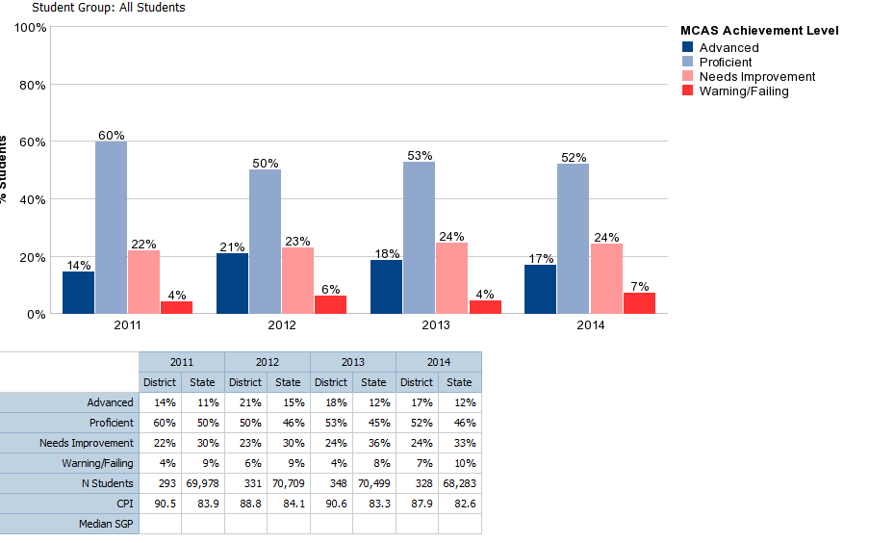
District Elementary: ELA Grade 3

Slide 32
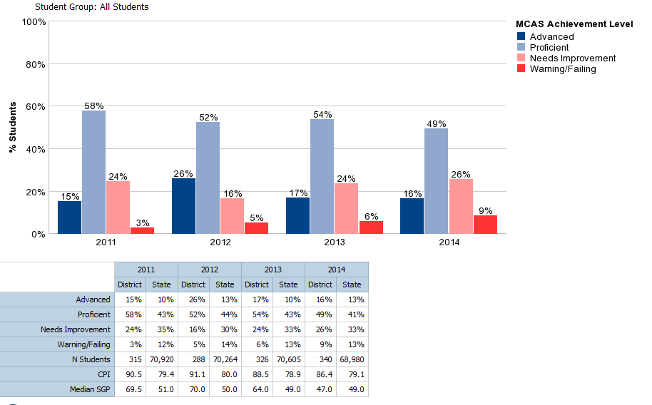
District Elementary: ELA Grade 4

Slide 33
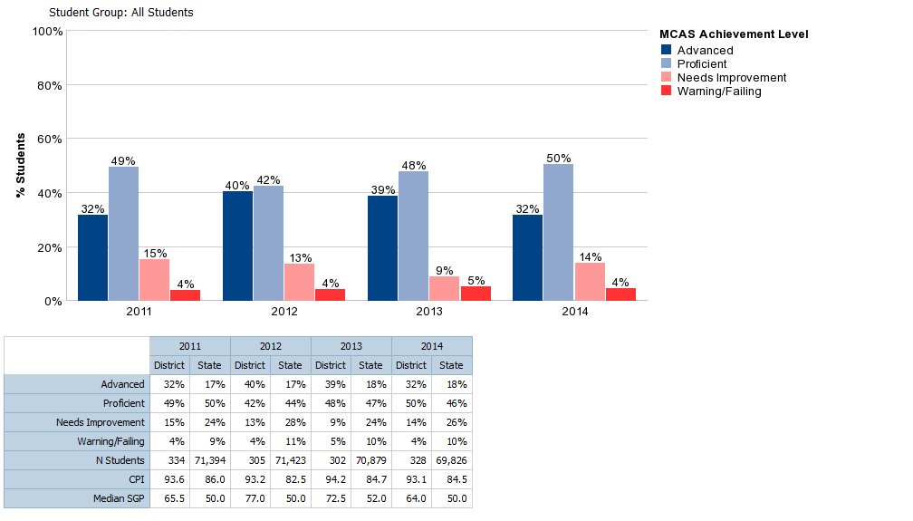
District Elementary: ELA Grade 5

Slide 34
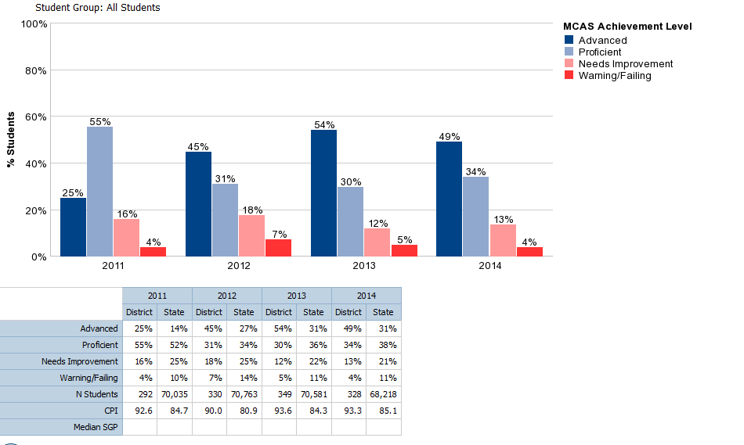
District Elementary: Math Grade 3

Slide 35
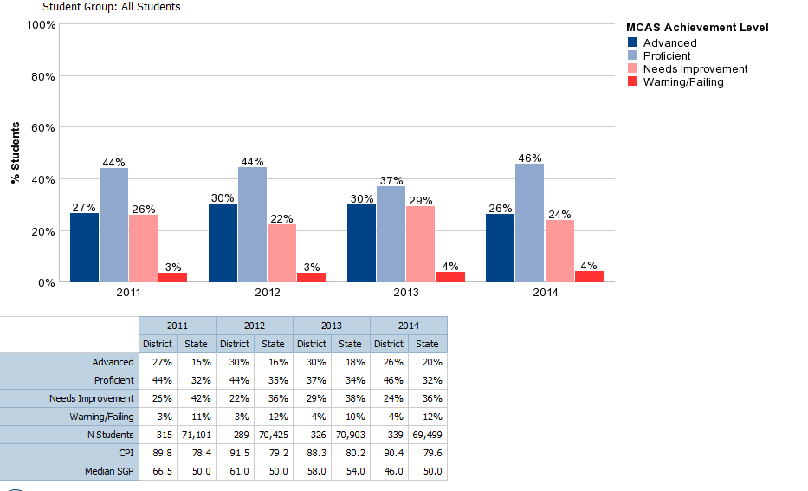
District Elementary: Math Grade 4

Slide 36
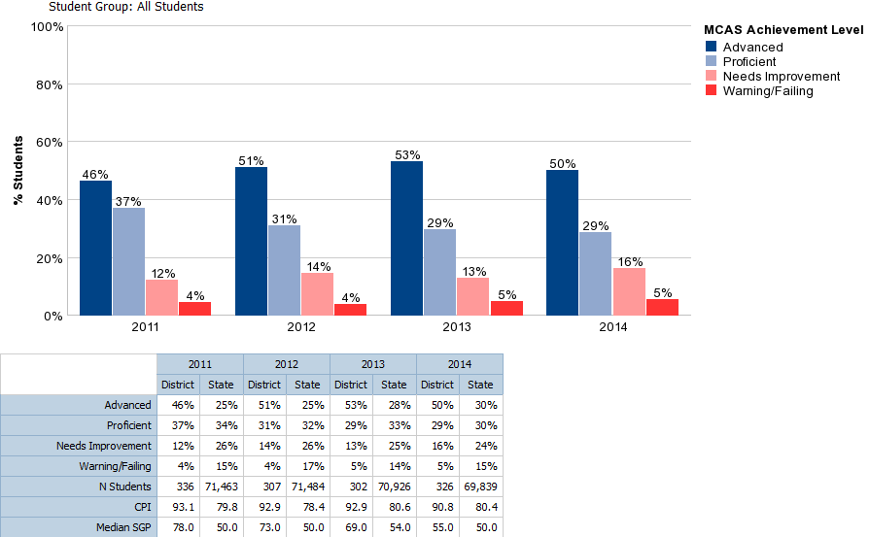
District Elementary: Math Grade 5

Slide 37
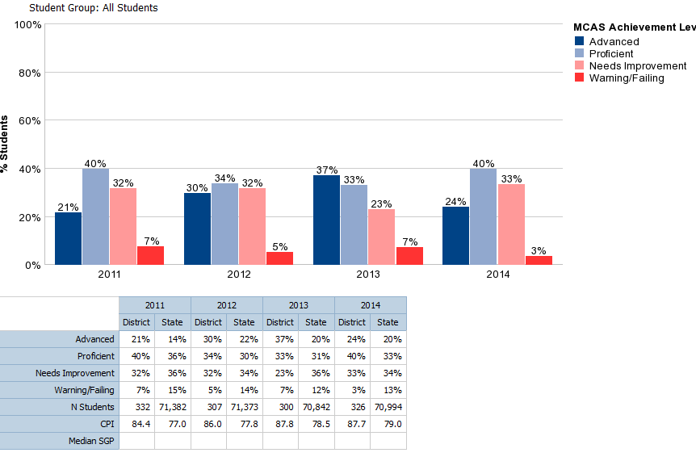
District Elementary: Science Grade 5

Slide 38
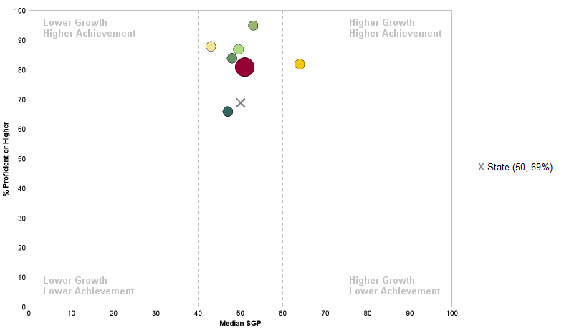
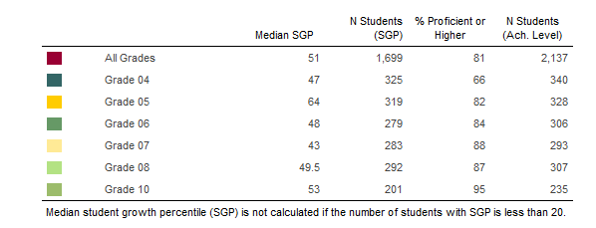
District
ELA Growth and Achievement

Slide 39
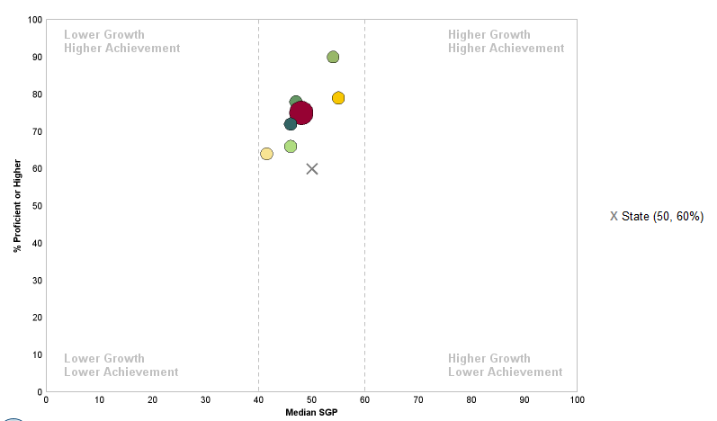
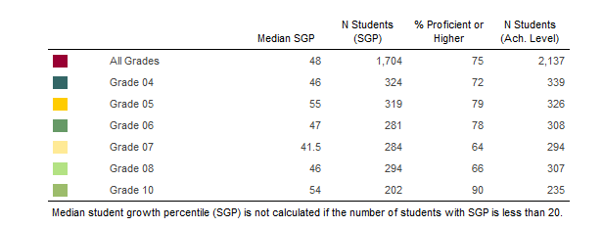
District
Math Growth and Achievement

Slide 40
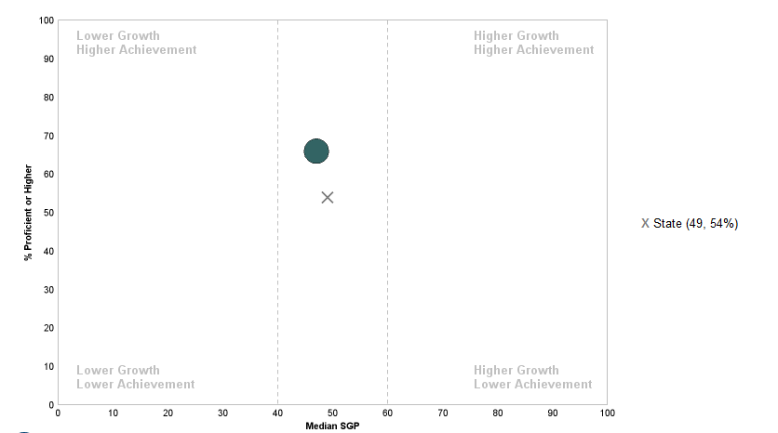
District
ELA
Grade 4 Growth and Achievement

Slide 41
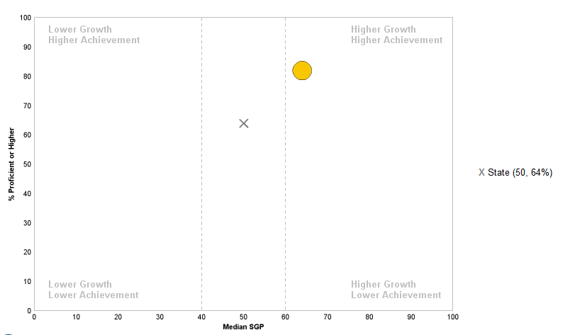
District
ELA Grade 5 Growth and Achievement

Slide 42
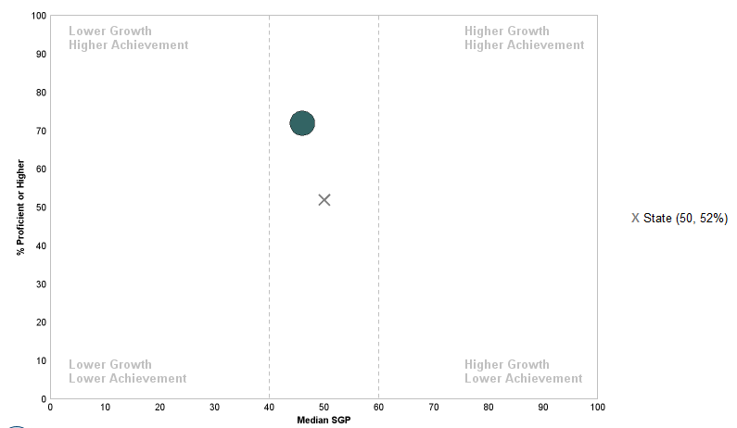
District
Math
Grade 4 Growth and Achievement

Slide 43
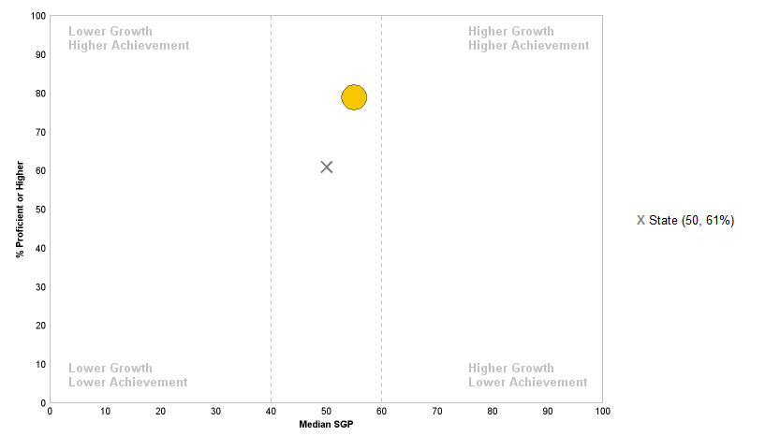
District Math Grade 5 Growth and Achievement

Slide 44
Low Income Subgroup (Grade 3)
ELA
 | 2010 | 2011 | 2012 | 2013 | 2014
CPI Non Low Income | 92.1 | 93.3 | 91.2 | 92.5 | 90.2
CPI Low Income | 80.7 | 75 | 72.6 | 77.3 | 69.6
Difference | 11.4 | 18.3 | 18.6 | 15.2 | 20.6
Math
 | 2010 | 2011 | 2012 | 2013 | 2014
CPI Non Low Income | 91.9 | 96 | 92.4 | 95.8 | 96.2
CPI Low Income | 72.3 | 73.9 | 73.8 | 78.9 | 70.3
Difference | 19.6 | 22.1 | 18.6 | 16.9 | 25.9
Have gaps in performance between student groups decreased over time? No
Have all groups of students gained over time? No
What is the magnitude of the gap between groups?
Notable- the gap is larger in mathematics.
How does each group of students currently perform relative to their counterparts in other schools, districts, or states? CPI for this subgroup is below the state subgroup in ELA and Math
Notes:
Math 76.2
ELA 72.7

Slide 45
African American/Black Subgroup (Grade 3)
ELA
 | 2010 | 2011 | 2012 | 2013 | 2014
CPI White | 92.8 | 94.1 | 92 | 92.7 | 91.2
CPI African Am./Black | 80.8 | 74.4 | 78.1 | 74.2 | 70.2
Difference | 12 | 19.7 | 13.9 | 18.5 | 21
Math
 | 2010 | 2011 | 2012 | 2013 | 2014
CPI White | 93.9 | 95.5 | 93.1 | 95.3 | 96.8
CPI African Am./Black | 68.1 | 76.1 | 79.7 | 80 | 75
Difference | 25.8 | 19.4 | 13.4 | 15.3 | 21.8
Have gaps in performance between student groups decreased over time?
ELA- No Math- No ELA
Have all groups of students gained over time?
No
What is the magnitude of the gap between groups?
Notable in Math and ELA
How does each group of students currently perform relative to their counterparts in other schools, districts, or states?
CPI for this subgroup is above the state subgroup in math and below in ELA
Notes:
ELA 72.4
Math 73.9

Slide 46
Special Education Subgroup (Grade 3)
ELA
 | 2010 | 2011 | 2012 | 2013 | 2014
CPI Non Spec Education | 93.4 | 93 | 91.7 | 93.4 | 93.4
CPI Spec Education | 80.7 | 79.2 | 76.2 | 72.3 | 63.5
Difference | 12.7 | 13.8 | 15.5 | 21.1 | 30.1
Math
 | 2010 | 2011 | 2012 | 2013 | 2014
CPI Non Spec Education | 92.9 | 94.8 | 92.9 | 96.1 | 97.2
CPI Spec Education | 76 | 83 | 77.4 | 77.2 | 75.8
Difference | 16.9 | 11.8 | 15.5 | 18.9 | 21.4
Have gaps in performance between student groups decreased over time?
No
Have all groups of students gained over time?
No
What is the magnitude of the gap between groups?
Notable in both ELA and Math
How does each group of students currently perform relative to their counterparts in other schools, districts, or states?
CPI for this subgroup is above the state subgroup.
Notes:
State- ELA 63.3 ; Math 66.8;

Slide 47
Low Income Subgroup (Grade 4)
ELA
 | 2010 | 2011 | 2012 | 2013 | 2014
CPI Non Low Income | 90.4 | 92.9 | 94.4 | 91.2 | 88.9
CPI Low Income | 70.7 | 75.6 | 72.1 | 67.6 | 67.5
Difference | 19.7 | 17.3 | 22.3 | 23.6 | 21.4
Math
 | 2010 | 2011 | 2012 | 2013 | 2014
CPI Non Low Income | 88 | 92 | 94.5 | 90.7 | 92.7
CPI Low Income | 68.1 | 75 | 75 | 69.6 | 73.1
Difference | 19.9 | 17 | 19.5 | 21.1 | 19.6
Have gaps in performance between student groups decreased over time? Yes, in Math and ELA
Have all groups of students gained over time? Yes in Math, ELA remained flat
What is the magnitude of the gap between groups?
Notable
How does each group of students currently perform relative to their counterparts in other schools, districts, or states? CPI for this subgroup is consistent with the state in ELA AND above the state subgroup in math.
Notes:
ELA 67.5
Math 69.4

Slide 48
African American/Black Subgroup (Grade 4)
ELA
 | 2010 | 2011 | 2012 | 2013 | 2014
CPI White | 91.8 | 94.4 | 95.6 | 92.96 | 89.5
CPI African Am./Black | 70.2 | 77.6 | 70.9 | 72.4 | 60.9
Difference | 21.6 | 16.8 | 24.7 | 20.2 | 28.6
Math
 | 2010 | 2011 | 2012 | 2013 | 2014
CPI White | 87.9 | 93.9 | 94.9 | 92.1 | 92.6
CPI African Am./Black | 70.2 | 71.4 | 75.6 | 73.5 | 75.8
Difference | 17.7 | 22.5 | 19.3 | 18.6 | 16.8
Have gaps in performance between student groups decreased over time? Yes- in Math, no in ELA
Have all groups of students gained over time? Yes in Math, no in ELA
What is the magnitude of the gap between groups?
Notable
How does each group of students currently perform relative to their counterparts in other schools, districts, or states? CPI for this subgroup is significantly above the state subgroup in math and below the state in math.
Notes:
Math 65.5
ELA 66.7

Slide 49
Special Education Subgroup (Grade 4)
ELA
 | 2010 | 2011 | 2012 | 2013 | 2014
CPI Non Spec Education | 92.8 | 94.7 | 94 | 92.4 | 90.5
CPI Spec Education | 62.7 | 76.4 | 75 | 69.6 | 65.6
Difference | 30.1 | 18.3 | 19 | 22.8 | 24.9
Math
 | 2010 | 2011 | 2012 | 2013 | 2014
CPI Non Spec Education | 88.8 | 94.2 | 94 | 92.1 | 93.9
CPI Spec Education | 66.9 | 74.6 | 78.3 | 69.5 | 72.8
Difference | 21.9 | 19.6 | 15.7 | 22.6 | 21.1
Have gaps in performance between student groups decreased over time? Yes
Have all groups of students gained over time? No- Non spec education; Yes- all other groups
What is the magnitude of the gap between groups?
Notable
How does each group of students currently perform relative to their counterparts in other schools, districts, or states? CPI for this subgroup is well above the state subgroup in ELA and math.
Notes:
State- ELA 55.9; Math 60.1;

Slide 50
Low Income Subgroup (Grade 5)
ELA
 | 2010 | 2011 | 2012 | 2013 | 2014
CPI Non Low Income | 93.6 | 95.8 | 94.8 | 95.8 | 94.6
CPI Low Income | 79.2 | 83.5 | 83.1 | 86.5 | 82.1
Difference | 14.4 | 12.3 | 11.7 | 9.3 | 12.5
Math
 | 2010 | 2011 | 2012 | 2013 | 2014
CPI Non Low Income | 88.7 | 95.9 | 95 | 96.1 | 93
CPI Low Income | 77.1 | 79.7 | 80.2 | 77.4 | 74.4
Difference | 11.6 | 16.2 | 14.8 | 18.7 | 18.6
Science
 | 2010 | 2011 | 2012 | 2013 | 2014
CPI Non Low Income | 86.7 | 87.8 | 89.5 | 90.6 | 88.9
CPI Low Income | 67.7 | 68.5 | 64.5 | 74 | 78.8
Difference | 19 | 19.3 | 25 | 16.6 | 10.1
Have gaps in performance between student groups decreased over time? No in ELA, flat in Math, Yes in Science
Have all groups of students gained over time? Yes
What is the magnitude of the gap between groups?
Double in Math as compared to ELA
How does each group of students currently perform relative to their counterparts in other schools, districts, or states? CPI for this subgroup is significantly above the state subgroup.
Notes:
Math 68.4
ELA 74.3
Science 66.3

Slide 51
African American/Black Subgroup (Grade 5)
ELA
 | 2010 | 2011 | 2012 | 2013 | 2014
CPI White | 93.8 | 95.6 | 95.6 | 96.2 | 95.6
CPI African Am./Black | 78.2 | 85.8 | 81.1 | 88 | 83.5
Difference | 15.6 | 9.8 | 14.5 | 8.2 | 12.1
Math
 | 2010 | 2011 | 2012 | 2013 | 2014
CPI White | 90.2 | 95.4 | 96.2 | 95.1 | 94.3
CPI African Am./Black | 72.2 | 83.8 | 76.7 | 79.3 | 77
Difference | 18 | 11.6 | 19.5 | 15.8 | 17.3
Science
 | 2010 | 2011 | 2012 | 2013 | 2014
CPI White | 88.1 | 88.6 | 90.3 | 91.6 | 89.9
CPI African Am./Black | 65.7 | 66.9 | 67.2 | 71.8 | 79.5
Difference | 22.4 | 21.7 | 23.1 | 19.8 | 10.4
Have gaps in performance between student groups decreased over time? All scores consistent with last year.
Have all groups of students gained over time? No
What is the magnitude of the gap between groups? Smallest in Science
How does each group of students currently perform relative to their counterparts in other schools, districts, or states? CPI for this subgroup is well above the state subgroup.
Notes:
Math 66
ELA 73.9
Science 62.2

Slide 52
Special Education Subgroup (Grade 5)
ELA
 | 2010 | 2011 | 2012 | 2013 | 2014
CPI Non Spec Education | 97.6 | 96.7 | 97.2 | 96 | 96.1
CPI Spec Education | 62.5 | 78.6 | 77.8 | 79.5 | 77.4
Difference | 35.1 | 18.1 | 19.4 | 16.5 | 18.7
Math
 | 2010 | 2011 | 2012 | 2013 | 2014
CPI Non Spec Education | 93.9 | 96 | 97.2 | 95.4 | 94.1
CPI Spec Education | 54.6 | 78.9 | 76.6 | 71.9 | 73.6
Difference | 39.3 | 17.1 | 20.6 | 23.5 | 20.5
Science
 | 2010 | 2011 | 2012 | 2013 | 2014
CPI Non Spec Education | 89 | 87.9 | 90.6 | 90 | 89.9
CPI Spec Education | 59 | 67.5 | 68.4 | 68.8 | 76
Difference | 30 | 20.4 | 22.2 | 21.2 | 13.9
Have gaps in performance between student groups decreased over time? No- ELA, Yes Science; Yes- Math
Have all groups of students gained over time? No-ELA; Yes-Math & Science
What is the magnitude of the gap between groups?
Notable in all content areas but narrowing over time.
How does each group of students currently perform relative to their counterparts in other schools, districts, or states? CPI for this subgroup is above the state subgroup in all content areas.
Notes:
State- ELA 62.9; Math 56.2; Science 60.7

Slide 53
Pierce Middle School 2014 MCAS Data

Slide 54
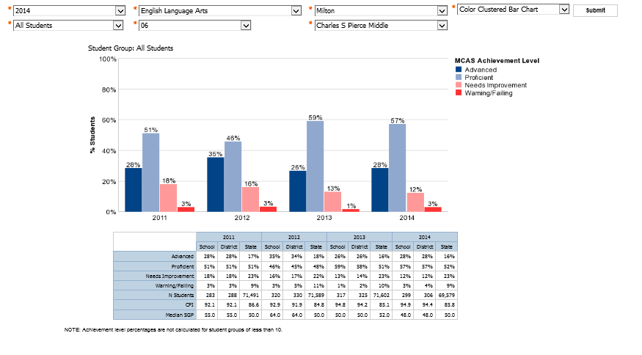
Pierce Middle School: ELA Grade 6

Slide 55
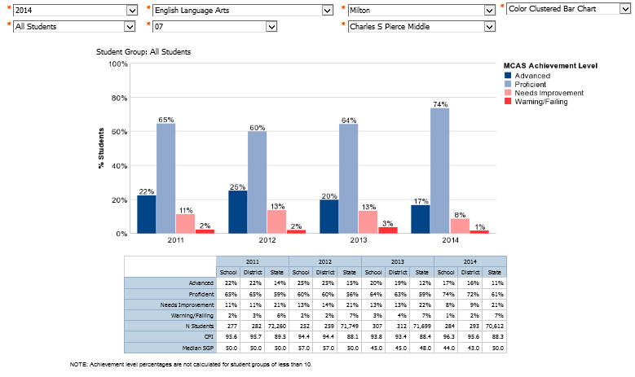
Pierce Middle School: ELA Grade 7

Slide 56
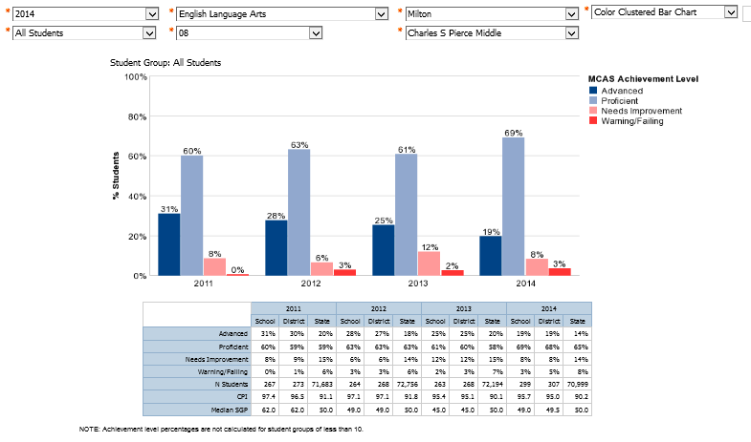
Pierce Middle School: ELA Grade 8

Slide 57
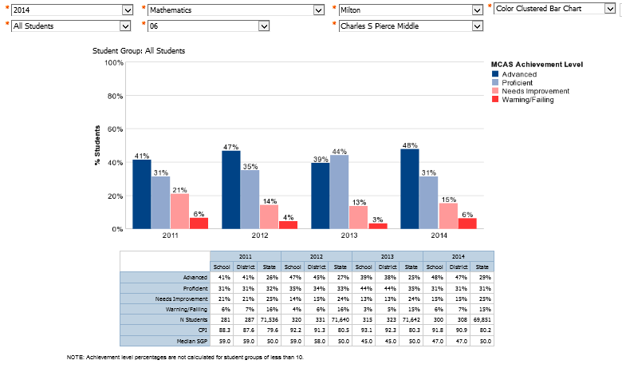
Pierce Middle School: Math Grade 6

Slide 58
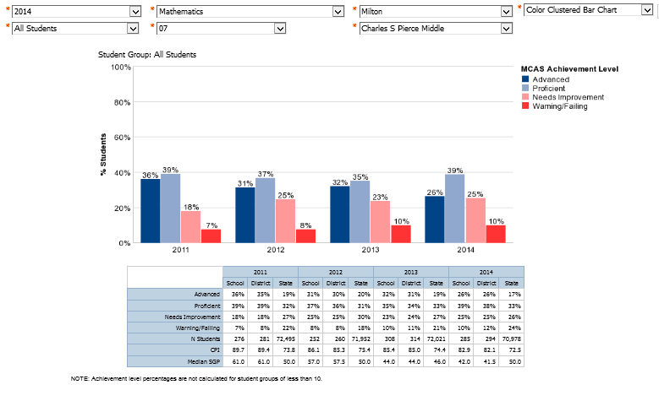
Pierce Middle School: Math Grade 7

Slide 59
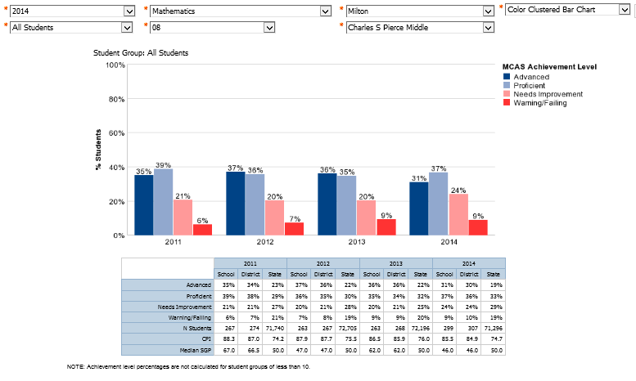
Pierce Middle School: Math Grade 8

Slide 60
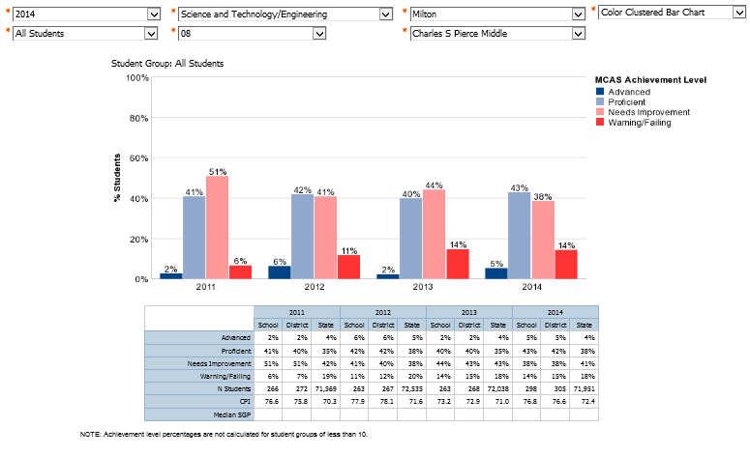
Pierce Middle School- STE Grade 8

Slide 61
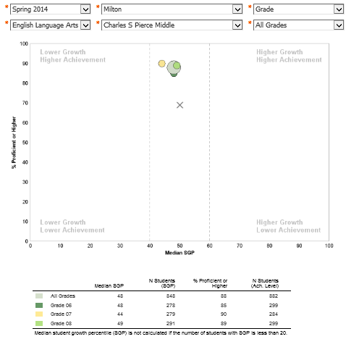
Pierce Middle School-ELA Growth and Achievement

Slide 62
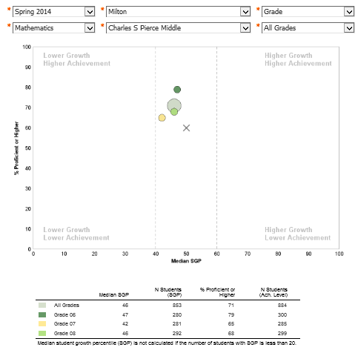
Pierce Middle School- Math Growth and Achievement

Slide 63
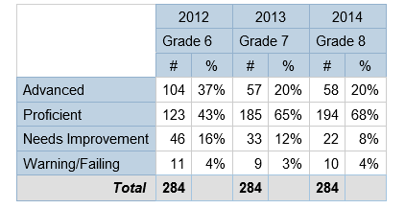
Pierce Middle School MCAS Cohort Achievement History
ELA
Students who took all tests in district.

Slide 64
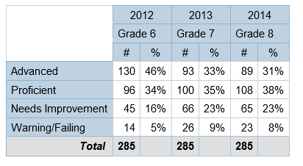
Pierce Middle School MCAS Cohort Achievement History
Mathematics
Students who took all tests in district.

Slide 65
Guiding Questions for Achievement Gap Analysis for Pierce Middle School
To gain a true picture of gaps in student achievement requires looking at the data from at least four different perspectives.
Simple Gap Narrowing- Have gaps in performance between student groups decreased over time?
Progress For All- Have all groups of students gained over time?
Group Size- What is the magnitude of the gap between groups?
Group Comparisons Across Jurisdictions- How does each group of students currently perform relative to their counterparts in other schools, districts, or states?
Taken from: Gauging the Gaps: A Deeper Look at Student Achievement, The Education Trust, January, 2010.

Slide 66
Low Income Subgroup
ELA
 | 2010 | 2011 | 2012 | 2013 | 2014
CPI Non Low Income | 95.7 | 96.5 | 96.7 | 96.4 | 96.8
CPI Low Income | 86.5 | 86.4 | 84.7 | 86.7 | 89.9
Difference | 9.2 | 10.1 | 12.0 | 9.7 | 6.9
Math
 | 2010 | 2011 | 2012 | 2013 | 2014
CPI Non Low Income | 90.6 | 91.6 | 92.3 | 91.9 | 90.1
CPI Low Income | 75.4 | 72.6 | 72.3 | 72.5 | 71.1
Difference | 15.2 | 19.0 | 20.0 | 19.4 | 19.0
Science
 | 2010 | 2011 | 2012 | 2013 | 2014
CPI Non Low Income | 79.8 | 80.0 | 81.8 | 76.5 | 80.9
CPI Low Income | 65.4 | 55.9 | 57.1 | 59.9 | 60.2
Difference | 14.4 | 24.1 | 24.7 | 16.6 | 20.7
Have gaps in performance between student groups decreased over time?
Yes-ELA; No-Math & Science
Have all groups of students gained over time?
Yes-ELA; No- Math & Science
What is the magnitude of the gap between groups?
ELA gap is declining. Gap is notably bigger in Math and Science compared to ELA.
How does each group of students currently perform relative to their counterparts in other schools, districts, or states?
The CPI for the Pierce low income subgroup is above CPI for the state low income subgroup in Math (+2.3) and ELA (+12.4). Science is below the State (-6.6).

Slide 67
African American/Black Subgroup
Have gaps in performance between student groups decreased over time?
Yes- ELA; No- Math & Science
Have all groups of students gained over time?
No
What is the magnitude of the gap between groups?
Closing in ELA; Particularly notable in math and science.
How does each group of students currently perform relative to their counterparts in other schools, districts, or states?
The CPI for the Pierce African Am/Black subgroup is above CPI for the state African Am/Black subgroup in Math (+1.0) and ELA (+12.5). Science is below the state-
(-4.8).
ELA
 | 2010 | 2011 | 2012 | 2013 | 2014
CPI White | 97.3 | 97.1 | 97.5 | 96.8 | 96.7
CPI African Am./Black | 86.4 | 87.7 | 85.0 | 87.2 | 90.5
Difference | 10.9 | 9.3 | 12.5 | 9.6 | 6.2
Math
 | 2010 | 2011 | 2012 | 2013 | 2014
CPI White | 92.4 | 93.5 | 92.9 | 93.1 | 91.5
CPI African Am./Black | 75.4 | 72.5 | 73.3 | 71.4 | 67.9
Difference | 17 | 21 | 19.6 | 21.7 | 23.6
Science
 | 2010 | 2011 | 2012 | 2013 | 2014
CPI White | 81.1 | 80.4 | 83..7 | 78.7 | 82.2
CPI African Am./Black | 62.5 | 67.3 | 56.3 | 54.9 | 59.5
Difference | 18.6 | 13.1 | 27.4 | 23.8 | 22.7

Slide 68
Special Education Subgroup
ELA
 | 2010 | 2011 | 2012 | 2013 | 2014
CPI Non Spec Education | 96.9 | 97.6 | 97.7 | 98.1 | 98
CPI Spec Education | 73.1 | 77.1 | 77.9 | 75.9 | 78.3
Difference | 23.8 | 20.5 | 19.8 | 22.2 | 19.7
Math
 | 2010 | 2011 | 2012 | 2013 | 2014
CPI Non Spec Education | 91.5 | 92.8 | 93.6 | 93.4 | 90.3
CPI Spec Education | 61.9 | 60.8 | 63.7 | 61.3 | 61
Difference | 29.6 | 32 | 29.9 | 32.1 | 29.3
Science
 | 2010 | 2011 | 2012 | 2013 | 2014
CPI Non Spec Education | 79 | 79.9 | 80.7 | 78.2 | 80.8
CPI Spec Education | 59.4 | 47.2 | 58.8 | 49.5 | 51.2
Difference | 19.6 | 32.7 | 21.9 | 28.7 | 29.6
Have gaps in performance between student groups decreased over time?
Yes- ELA No- Math & Science
Have all groups of students gained over time?
Yes- ELA ; No- Math & Science
What is the magnitude of the gap between groups?
Notable in all subjects.
How does each group of students currently perform relative to their counterparts in other schools, districts, or states?
The CPI for the Special Education subgroup is above CPI for the state Special Education subgroup in Math (+3.9) and ELA (+11.7). Science is below the state- (-8.9).

Slide 69
Milton High School 2014 MCAS Data

Slide 70
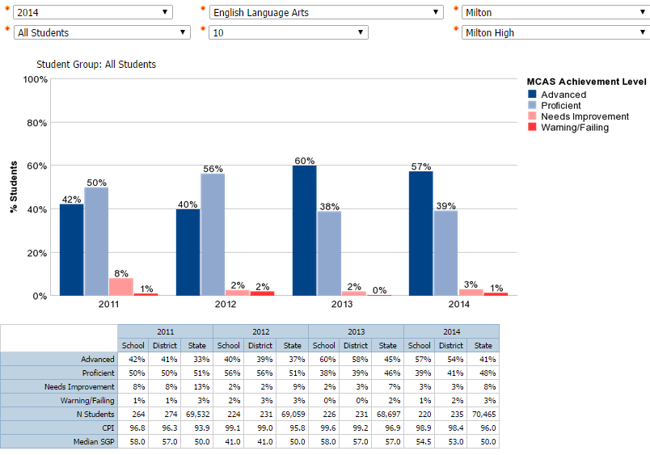
Milton High School – ELA Grade 10

Slide 71
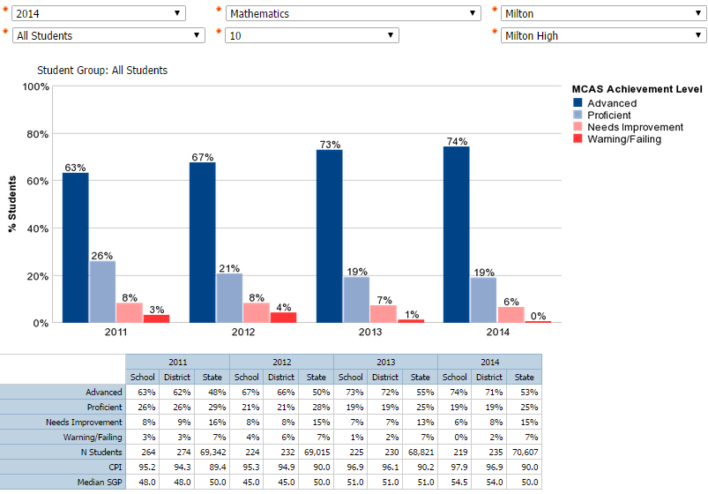
Milton High School – Math Grade 10

Slide 72
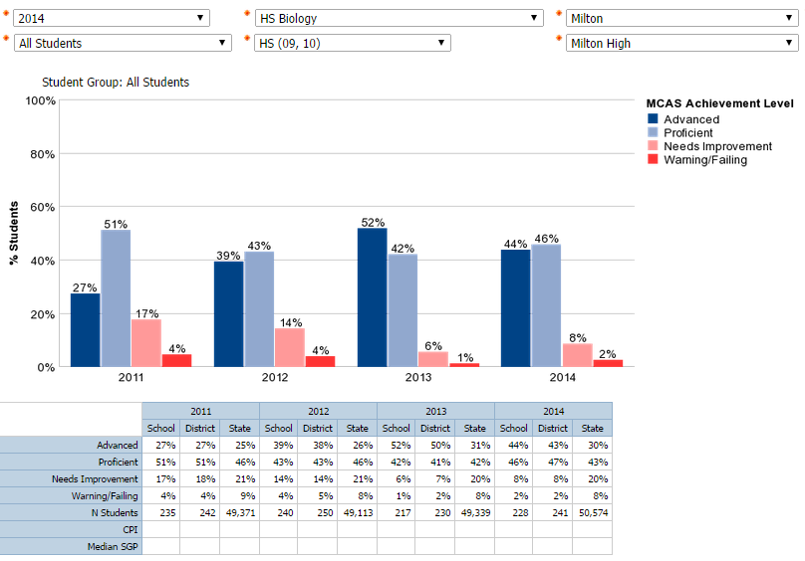
Milton High School – Biology

Slide 73
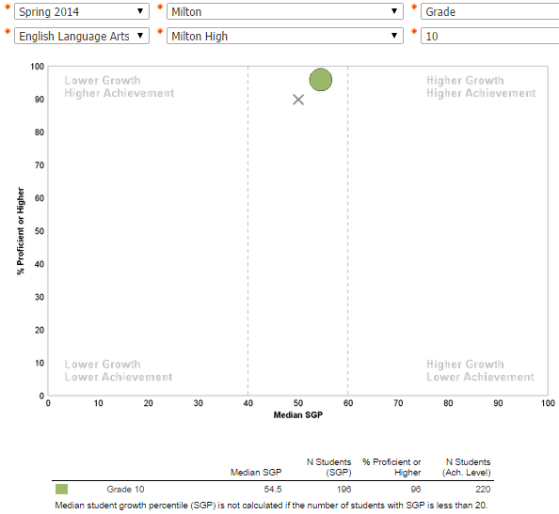
Milton High School-ELA Growth and Achievement

Slide 74
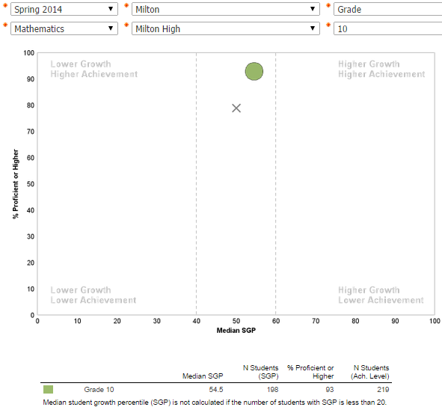
Milton High School-Math Growth and Achievement

Slide 75
Milton High School MCAS Achievement History
% Advanced/Proficient
 | 2011 | 2012 | 2013 | 2014
Grade 10 ELA | 92% | 96% | 98% | 96%
Grade 10 Math | 89% | 88% | 92% | 93%
Grade 10 Science and Tech./Engineering* | 75% | 82% | 85% | 94%
HS Biology (Gr. 9/10) | 78% | 82% | 94% | 89%

Slide 76
Milton High School MCAS Cohort DATA
ELA (% Advanced/Proficient)
 | Grade 7 | Grade 8 | Grade 9 | Grade 10
Class of 2014 | 85% | 87% | X | 96%
Class of 2015 | 83% | 91% | X | 98%
Class of 2016 | 87% | 91% | X | 96%
Class of 2017 | 85% | 86% | X | X
Math (% Advanced/Proficient)
 | Grade 7 | Grade 8 | Grade 9 | Grade 10
Class of 2014 | 61% | 75% | X | 88%
Class of 2015 | 64% | 73% | X | 92%
Class of 2016 | 75% | 73% | X | 93%
Class of 2017 | 68% | 71% | X | X
Science and Technology/Engineering (% Advanced/Proficient)
 | Grade 7 | Grade 8 | Grade 9 (Bio) | Grade 10
Class of 2014 | X | 46% | 78% | 82%
Class of 2015 | X | 43% | 82% | 85%
Class of 2016 | X | 48% | 94% | 94%
Class of 2017 | X | 41% | 89% | X

Slide 77
Milton High School High needs subgroup
ELA Grade 10 Students (% Advanced/Proficient)
 | 2011 | 2012 | 2013 | 2014
High Needs | 72% | 85% | 93% | 89%
Non-High Needs | 98% | 99% | 100% | 99%
Math Grade 10 Students (% Advanced/Proficient)
 | 2011 | 2012 | 2013 | 2014
High Needs | 72% | 68% | 68% | 80%
Non-High Needs | 94% | 94% | 100% | 97%

Slide 78
Milton High School High needs subgroup
Science and Tech/Engineering Grade 10* Students (% Advanced/Proficient)
 | 2011 | 2012 | 2013 | 2014
High Needs | X | X | 52% | 84%
Non-High Needs | X | X | 96% | 97%
HS Biology (% Advanced/Proficient)
 | 2011 | 2012 | 2013 | 2014
High Needs | 57% | 50% | 84% | 75%
Non-High Needs | 87% | 95% | 96% | 95%

Slide 79
MHS - Low Income Subgroup
ELA | 2010 | 2011 | 2012 | 2013 | 2014
CPI Non-Low Income | 97.1 | 98 | 99.2 | 99.7 | 99.5
CPI Low Income | 85.1 | 90.9 | 98.6 | 98.8 | 96.1
Difference | 12 | 7.1 | 0.6 | 0.9 | 3.4
Have gaps in performance between student groups decreased over time?
Yes-ELA, Math ,Science
Have all groups of students gained over time?
Yes-ELA, Math ,Science
What is the magnitude of the gap between groups?
Recent increase in ELA;
Decrease in math;
Significant decrease in Science
Math | 2010 | 2011 | 2012 | 2013 | 2014
CPI Non-Low Income | 95.8 | 96.8 | 96 | 98.2 | 98.5
CPI Low Income | 77.6 | 86.9 | 91.7 | 91.3 | 95
Difference | 18.2 | 9.9 | 4.3 | 6.9 | 3.5
Science | 2010 | 2011 | 2012 | 2013 | 2014
CPI Non-Low Income | 92.9 | 92.7 | 94 | 96.7 | 98.9
CPI Low Income | 74.4 | 82.1 | 89.3 | 84.2 | 95.5
Difference | 18.5 | 10.6 | 4.7 | 12.5 | 3.4

Slide 80
MHS - African Am./Black Subgroup
Have gaps in performance between student groups decreased over time?
Yes – ELA, Math, Science
Have all groups of students gained over time?
Yes – ELA, Math, and Science
What is the magnitude of the gap between groups?
Recent increase in ELA and Math
Significant decrease in Science
ELA | 2010 | 2011 | 2012 | 2013 | 2014
CPI White | 98.3 | 99.1 | 99.7 | 99.8 | 99.8
CPI African Am./Black | 88 | 92.2 | 98.1 | 99.5 | 97.9
Difference | 10.3 | 6.9 | 1.6 | 0.3 | 1.9
Math | 2010 | 2011 | 2012 | 2013 | 2014
CPI White | 96.3 | 98.1 | 97.5 | 98.4 | 99.1
CPI African Am./Black | 84 | 89 | 87 | 95.3 | 93.9
Difference | 12.3 | 9.1 | 10.5 | 3.1 | 5.2
Science | 2010 | 2011 | 2012 | 2013 | 2014
CPI White | 94.3 | 94.7 | 95.3 | 97.2 | 98.9
CPI African Am./Black | 77.7 | 82.1 | 87.2 | 91.1 | 96.7
Difference | 16.6 | 12.6 | 8.1 | 6.1 | 2.2

Slide 81
MHS - Special Education Subgroup
Have gaps in performance between student groups decreased over time?
Yes- ELA, Math, Science
Have all groups of students gained over time?
Yes- ELA, Math, Science
What is the magnitude of the gap between groups?
Slight gap increase in ELA;
Significant decreases in Math and Science
ELA | 2010 | 2011 | 2012 | 2013 | 2014
CPI Non. Spec. Education | 97.3 | 99.1 | 99.8 | 99.9 | 99.5
CPI Spec. Education | 74 | 76.9 | 92.1 | 96.4 | 93.2
Difference | 23.3 | 22.2 | 7.7 | 3.5 | 6.3
Math | 2010 | 2011 | 2012 | 2013 | 2014
CPI Non Spec. Education | 95.6 | 97.6 | 97.4 | 98.8 | 98.5
CPI Spec. Education | 64.8 | 74.1 | 73.8 | 79.5 | 93.2
Difference | 30.8 | 23.5 | 23.6 | 19.3 | 5.3
Science | 2010 | 2011 | 2012 | 2013 | 2014
CPI Non Spec. Education | 92.7 | 93.8 | 94.3 | 96.9 | 98.7
CPI Spec. Education | 59.8 | 66.3 | 78.6 | 73.9 | 96.3
Difference | 32.9 | 27.5 | 15.7 | 23 | 2.4
Notes:
State- ELA 67.1; Math 50.6; Science 50.1

