Slide 1
Racism
Sexual Misconduct
Hate
Harassment
Bullying
Incident Reporting
Cyber
Discrimination
Retaliation
Threats
Gender

Slide 2
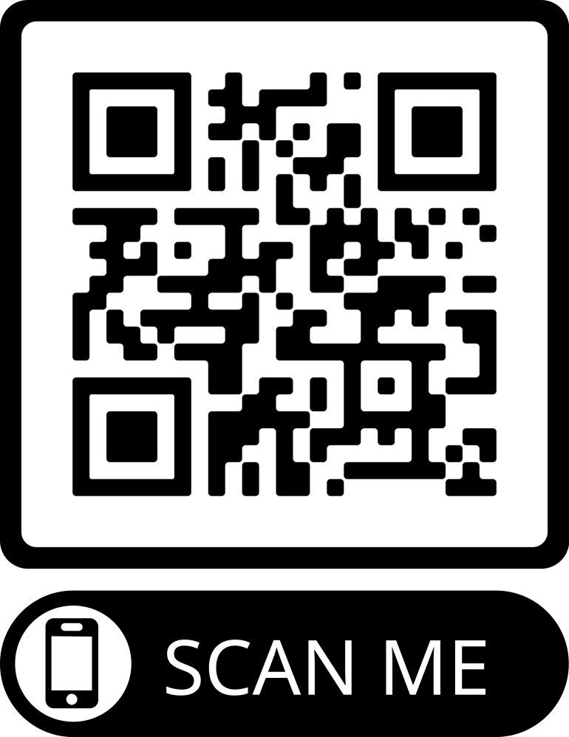
Ways to Report!
Hard Copies
Forms are located in the :
Equity Office (HS building)
Front Office
Nurse’s Office
Guidance
Online
Forms are Located in the :
www.miltonps.org/school-committee/bullyingpeer-aggression-information
Home school website

Slide 3
When Should You Report!
Feel Unsafe
Witness to an Incident
Experiencing Harmful Behaviors
Experiencing Harmful Words
Unsure and Need Help Processing
Need Support with the Experience

Slide 4
Incidents Involving:
Reports Go To:
Teacher/Coach
Department Heads
Principal
Equity Office
Central Office
Reports Go To:
Department Heads
Principal
Equity Office
Central Office
Reports Go To:
Equity Office
Central Office
Reports Go To:
Title 9 Officere and/or
School Committee

Slide 5
The Process!
Outreach to Appropriate Parties Involved
Investigation by certified Personnel Respecting the Rights of All Parties
Safety Protocols Enacted
Incident Reported
Outcome and Next Steps
The District aims to approach behaviors through a Restorative Lens. Our goal is to help learners better navigate their behaviors, cultivate respecting relationships, and restore the harm that has been inflicted so they can become productive for themselves and their communities.
Action…
Safety Plan…

